Slide 1
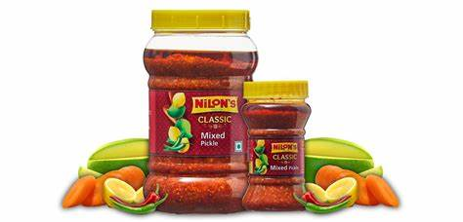
Project on Entrepreneurship
DEVELOPMENT OF PICKLE MANUFACTURING FACTORY
GUIDED BY:-
projecteD BY:-
DR. APURBA GIRI (Assistant Professor and Head)
AYAN MONDAL (Assistant Professor)
Dept. of Nutrition
Mugberia Gangadhar Mahavidyalaya
MR. ASHES KUMAR KHATUA
Roll: 0428
B.Voc (Food Processing, 6th Sem)
Dept. of Nutrition
Mugberia Gangadhar Mahavidyalaya

Slide 2
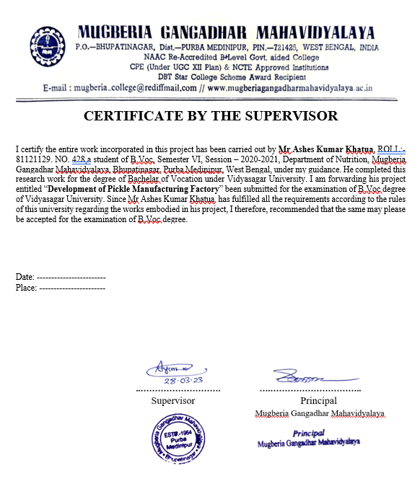

Slide 3
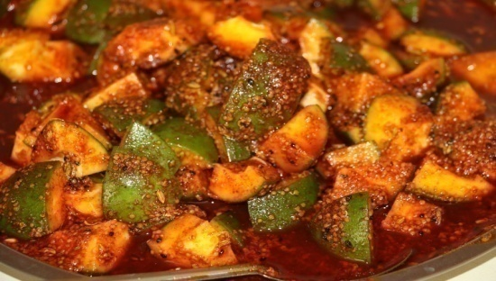
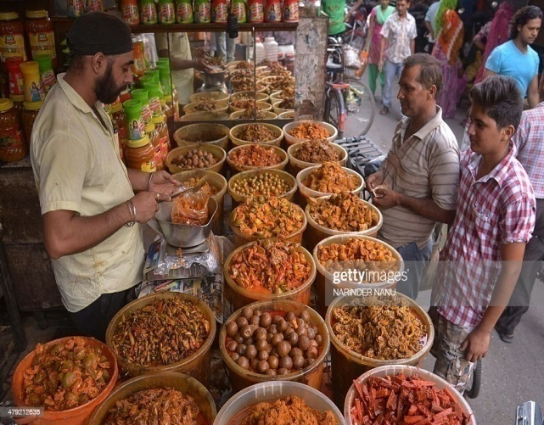
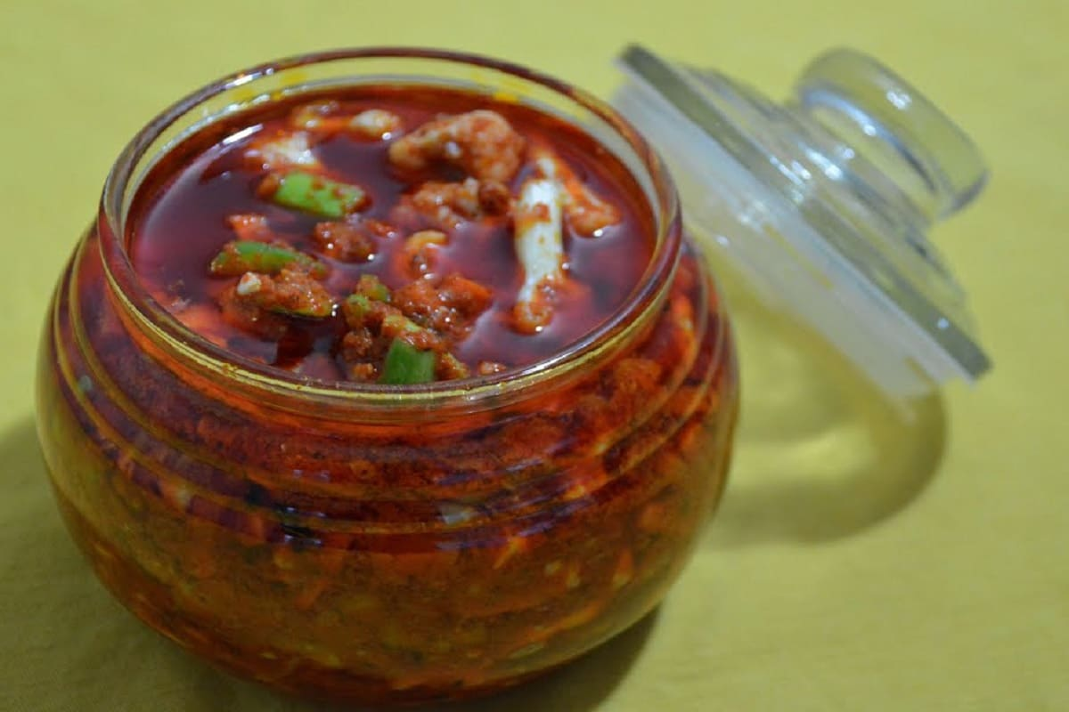
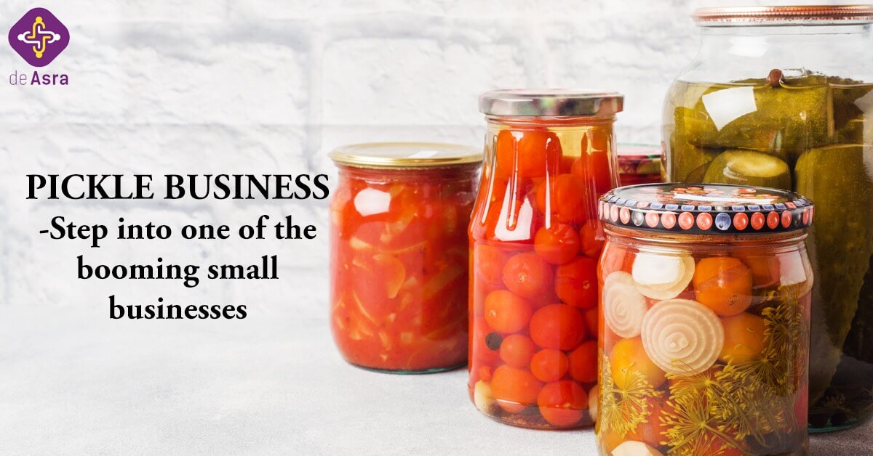
PICKLE MANUFACTURING BUSINESS
BUSINESS RESEARCH
MACHINERY
INVESTMENT
RAW MATERIALS
TARGETED CUSTOMERS
AREA & MANPOWER
PROFIT
LICENSES
MARKET STRATEGY
REWARD AND PUNISHMENT
PLANT LAYOUT

Slide 4
BUSINESS RESEARCH
DEMAND
SUPPLY
PRICE
QUALITY
QUANTITY

Slide 5
TYPES OF PICKLES
RAW MANGO PICKLE
SWEET MANGO PICKLE
SOUR MANGO PICKLE
TAMARIND PICKLE
MIXED PICKLE
RED CHILLI PICKLE
SOUR LEMON PICKLE
TOMATO PICKLE, ETC.

Slide 6
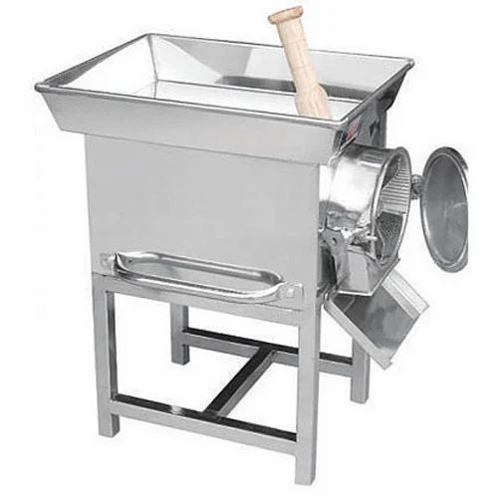
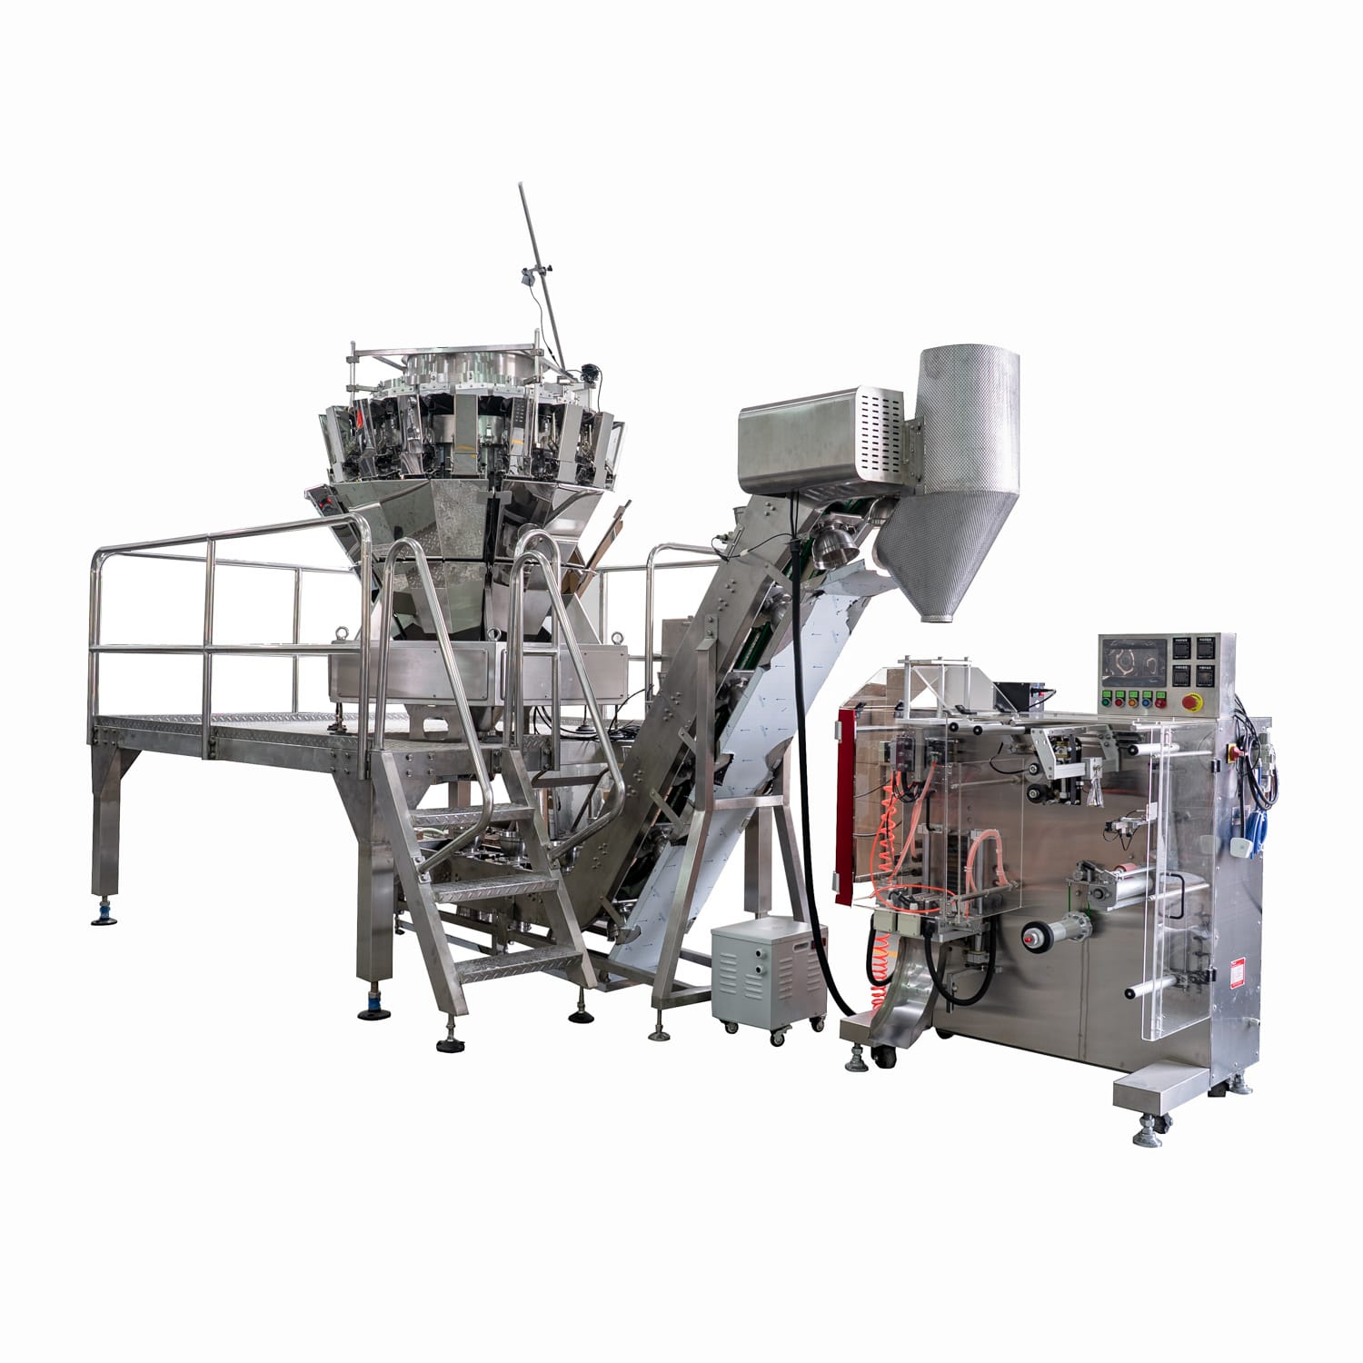
MACHINERY
POUNDING MACHINE
VEGETABLE DEHYDRATOR
COOKING ARRANGEMENTS
GRINDER
PICKLE MIXER
WEIGHING SCALE
UTENSILS,ETC.

Slide 7
INVESTMENT
CAPITAL: 80K-6LAKHS

Slide 8
RAW MATERIALS
VINEGAR
HERBS: GINGER,GARLIC,DILL
SPICES: MUSTARD SEED, CHILI POWDER, TURMERIC, ETC.
VEGETABLE OIL: OLIVE, SUNFLOWER, COCONUT OILS, ETC.
SEA SALT, TABLE SALT, IODINE SALT, PICKLING SALT
SYRUP, SUGAR, MOLASSES
ALUM-THIS GIVES PICKLES ITS CRISPINESS

Slide 9
Manufacturing process design
Fresh
Vegetables
For
Pickling
Brining
&
Desalting
Packing
And
Labelling
Washing
Cutting
Cooking
Wastewater
Discharge
Wastewater
Discharge

Slide 10
TARGETED CUSTOMERS
WHOLESALERS
RETAILERS
RESTAURANTS
HOTELS
HOUSEHOLD
ONLINE
SUPERMARKETS, OTHERS
YOU CAN SELL ONLINE AS WELL AS OFFLINE
ONLINE WEBSITES LIKE INDIAMART, TRADEINDIA, ALIBABA, EXPORTERSINDIA,BIGBASKET,
AMAZON, FLIPKART, ETC.

Slide 11
AREA
900 – 1200 SQ.FT
MANPOWER
4 – 6 LABOURS
Salary - 7.5K

Slide 12
PROFIT
DEPENDING ON PRODUCTION
&
BUSINESS MODEL
RETURN WILL DEPEND ON
QUALITY, SIZE, TYPE, PRODUCTION
COST

Slide 13
LICENSES
REGISTRATION OF BUSINESS
NOC PAPER(FORM STATE POLLUTION CONTROL)
TRADE LICENSE
GST
FSSAI
IEC CODE
REGISTRATION FOR TRADEMARK

Slide 14
MARKET STRATEGY
Firstly, Digital Marketing
Secondary, Advertising
Thirdly, Sales Promotion
Fourth, Direct Marketing

Slide 15
REWARD AND PUNISHMENT
EXTRA INCENTIVE
PROMOTION
TOUR & TRAVEL
DISCHARGE POSITION
LOSS OF ACTIVITY

Slide 16
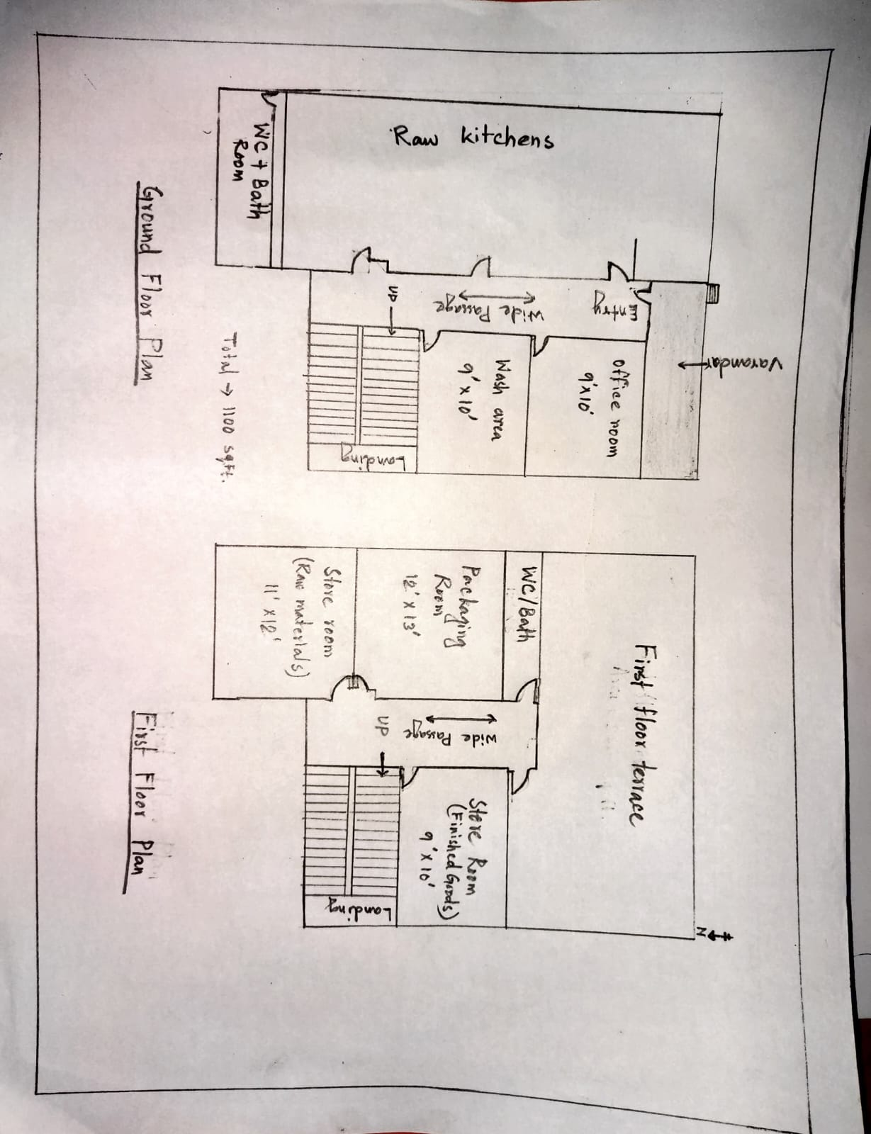
PLANT LAYOUT

Slide 17
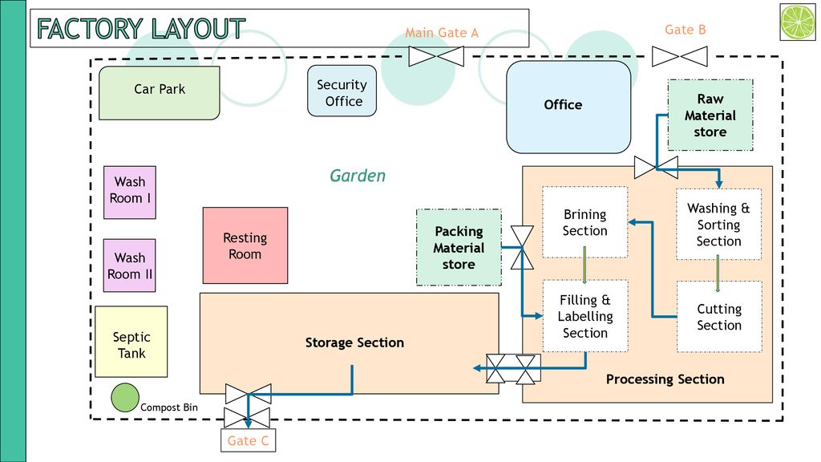
Factory layout
Main
Gate-1
h
as
Gate-2
Security
Office
Office
Raw Materials
Store
Garden
LAB
Wash Room 1
Electricity Room
Packaging
Materials
Store
Brining
Section
Washing
&
Sorting
Section
Machine Room
Wash Room 2
Filling&
Labelling
Section
Cutting
Section
Gate-3

Slide 18
THANK YOU

